Slide 1
Assessing the Impact of Property Features on Price of a Home
Abhishek Dendukuri

Slide 2
Introduction
Zestimate - a proprietary formula that computes the estimated market value of a home
Generates a comparative market analysis
Determines a valuation similar to one given by a real estate agent.

Slide 3
Problem and Hypothesis
There is no way of assessing whether or not Zestimate is the most reliable way to predict home prices.
There are certain features that seem to hold much higher value than the rest
Hypothesis: A better estimate can be made with only a subset of the features that Zillow provides than with all the features

Slide 4
Data Cleaning and Wrangling

Slide 5
Data Types in the dataset
The variables can be separated into three broad categories
Int
Num
Factor
Int and Num are considered continuous variables while Factor is a categorical variable
For our analysis we want continuous variables

Slide 6
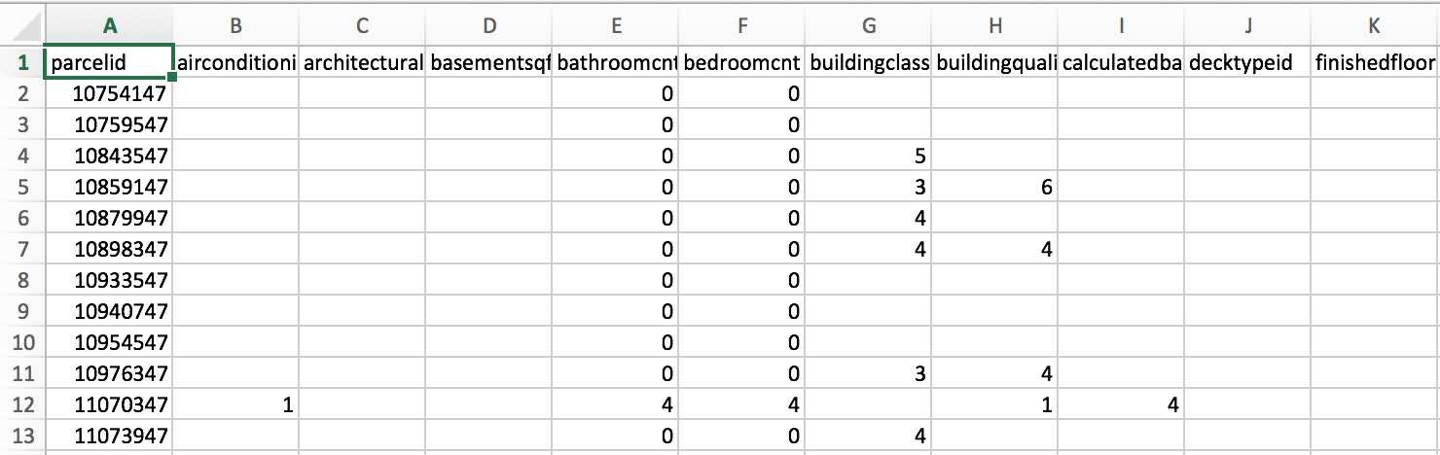
Missing Data
A peek into the data reveals several blank values but are considered NA meaning data is missing
We want as many data points as possible in order to:
decrease error
better predict housing price

Slide 7
Missing Data
We can treat the data by removing features that have too many missing values
Next slide will illustrate how many values are missing for each feature

Slide 8
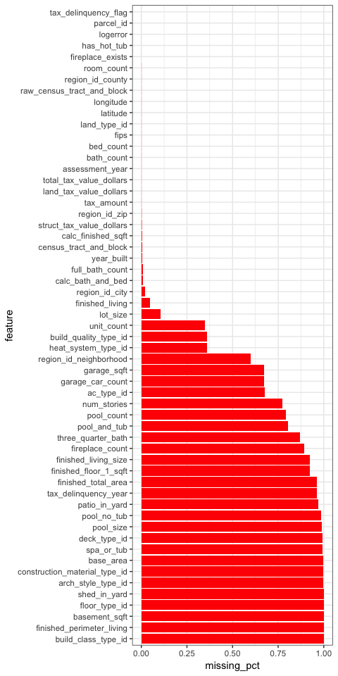
Missing Data
The chart reveals a natural cutoff at .125
We can limit out data accordingly

Slide 9
Data Exploration

Slide 10
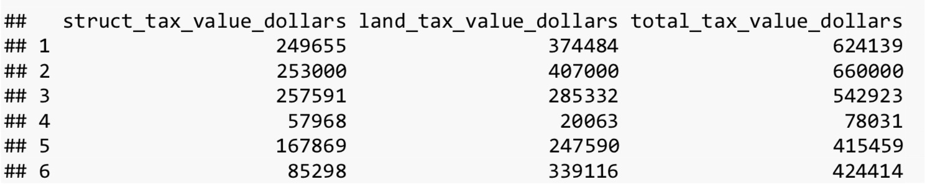
Data Exploration
The data above was extracted from the cleaned data
Total_tax_value_dollars represents the estimated cost of the home
Struct_tax_value_dollars + land_tax_value_dollars = total_tax_value_dollars

Slide 11
Correlation Plot
From the cleaned data we can generate a plot that reveals how the remaining features correlate to one another
A bigger circle represents a more significant correlation
A red circle represents a negative correlation
A blue circle represents a positive correlation

Slide 12
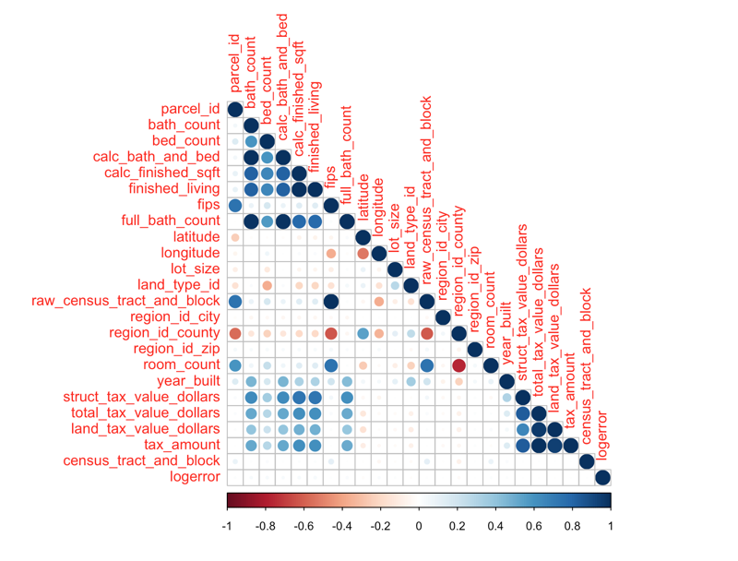
Correlation Plot

Slide 13
Correlation Plot
As we saw earlier, total_tax_value_dollars is the variable that shows price
We can see that there are certain values that reveal a strong correlation to that variable
We can create a smaller correlation plot that shows those strong correlations

Slide 14
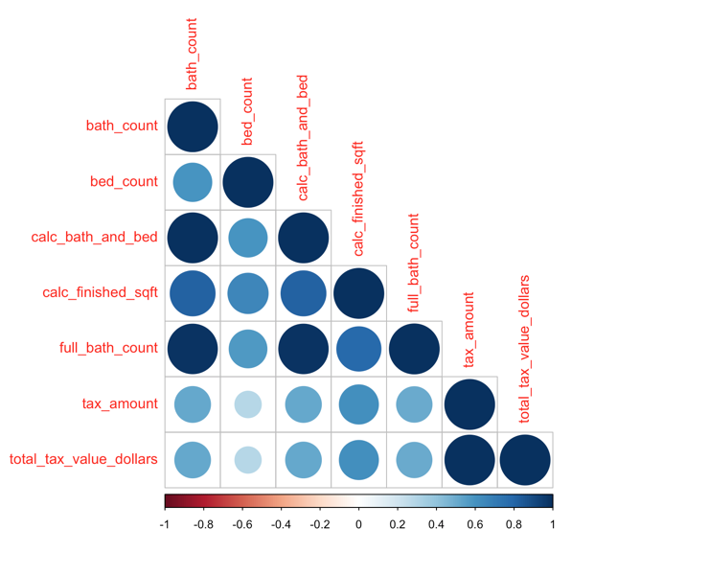
Correlation Plot 2

Slide 15
Correlation Plot 2
There are relatively strong correlations with total_tax_value_dollars among the following variables:
bed_count
bath_count
calc_bath_and_bed
calc_finished_sqft
full_bath_count
tax_amount
We can see the distribution of some of these variables using histograms

Slide 16
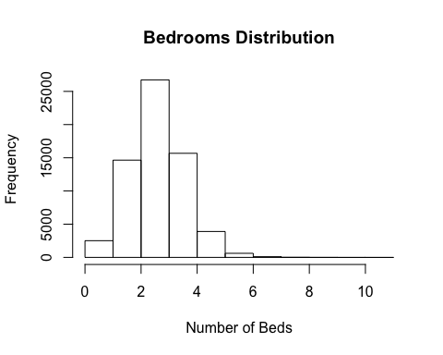
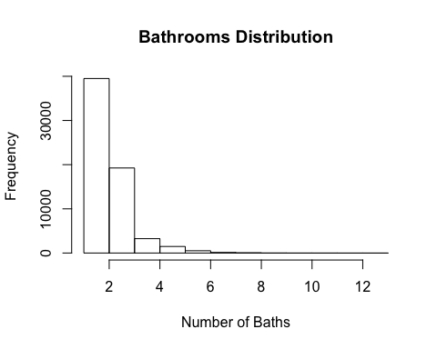
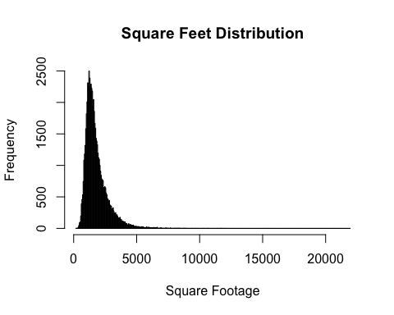
Distribution of Correlated Data

Slide 17
Distribution of Correlated Data
A pattern can be found amongst the histograms
The ranges for the highest frequencies
1-3 bedrooms
1-2 bathrooms
1000-3000 square feet
These ranges seem very typical of an average home

Slide 18
Machine Learning

Slide 19
Random Forest
bagging (bootstrap aggregating)
a method that turns a single tree with high variance into something with fairly high predictive power
The disadvantage to bagging is that if several trees are made, they share the same info -> tree correlation
Random forest is a modification to bagging
de-correlated trees lead to higher predictive power

Slide 20
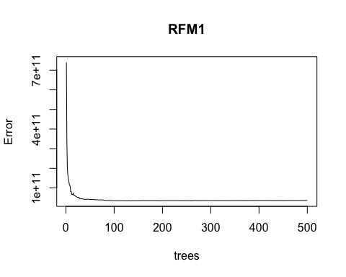
Baseline plot
The Baseline plot uses all the features and see their correlation to total_tax_value_dollars

Slide 21
Baseline Plot
Trees with lowest mean square error: 110
Root mean square error: 185, 123.7

Slide 22
Variable Importance Plot
In order to narrow down the most significant variables we can use a variable importance plot
We can see how well each features node purity is affected by total_tax_value_dollars

Slide 23
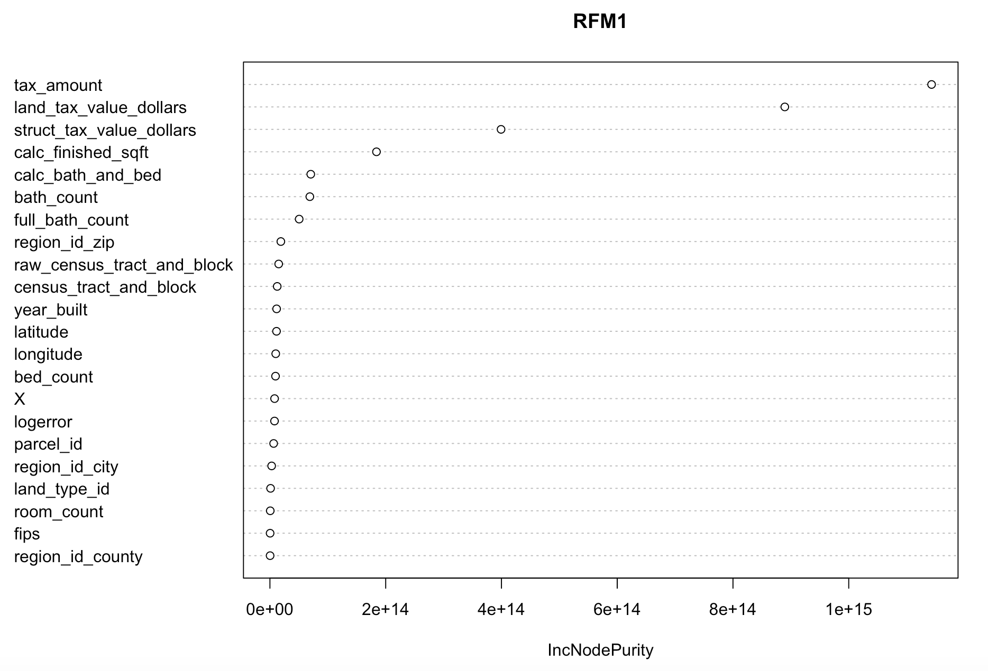
Variable Importance Plot

Slide 24
Variable Importance Plot
In the plot we can see that the following features were the most important
Tax_amount
Land_tax_value_dollars
Struct_tax_value_dollars
Calc_finished_sqft
Calc_bath_and_bed
Bath_count
Full_bath_count
These features can be fed into the testing plot data

Slide 25
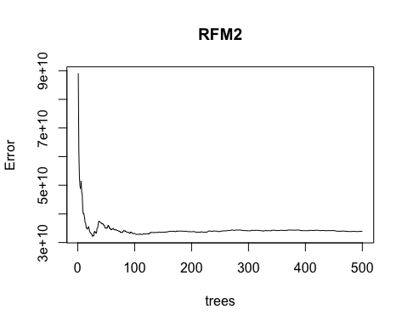
Testing Plot
The testing plot uses a subset of features that showed a significant node purity in the variable importance plot

Slide 26
Random Forest: Test Plot
Trees with lowest mean square error: 48
Root mean square error: 179,299

Slide 27
What does this mean?
The lower the root mean square the error, the better the prediction
The Testing Plot had a lower RMSE, and was therefore the better predictor than the Baseline Plot

Slide 28
Conclusion

Slide 29
Conclusion
Hypothesis was proven correct – the subset of features had a better error rate than the full set of features
Not every variable carries highly significant value

Slide 30
Limitations
The error rate was still really high
Missing data in the original dataset
Using only one machine learning model

Slide 31
Further Exploration
Looking into other major metropolitan cities – data was only available for Los Angeles
Other environmental variables that can determine valuation that are more complex to represent
neighborhood safety
school ranking

